Slide 1

Memory Technologies Spring 2024
Hamed Farbeh
farbeh@aut.ac.ir
Department of Computer Engineering
Amirkabir University of Technology

Slide 2
Grading
Final Exam: 65%
Homework and Project: 20%
Class Activities and Presentation: 15%
Memory Technologies, Spring 2024, AUT, Tehran, Iran

Slide 3
Course Outline
Memory Design and Memory Hierarchy
Traditional Semiconductor Memories
Nonvolatile Memories (NVMs)
An Overview of Cache Principles
An Overview of DRAMs
Replacing SRAM/DRAM with Emerging NVMs
Challenges and Opportunities
PCM, STT-MRAM, SOT-MRAM, ReRAM, FeRAM
Cutting-edge topics
Memory Technologies, Spring 2024, AUT, Tehran, Iran

Slide 4
Reference (for this lecture)
Design Exploration of Emerging Nano-scale Non-volatile Memory, Hao Yu and Yuhao Wang, Springer, 2014
Memory Technologies, Spring 2024, AUT, Tehran, Iran

Slide 5
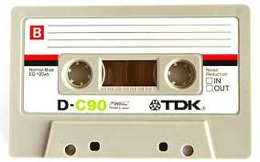
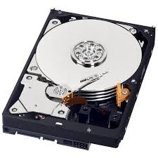
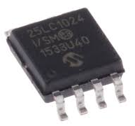
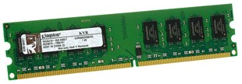
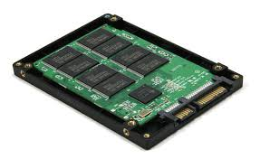
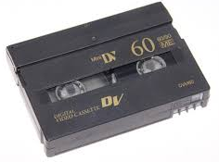
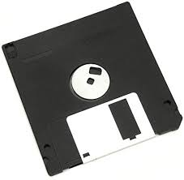
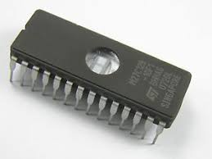


Memory
Memory is any physical device that is able to temporarily or permanently hold the state of information.
SRAM, DRAM, HDD, …
Memory Technologies, Spring 2024, AUT, Tehran, Iran

Slide 6
Memory Characteristics
Access time
Energy
Density
Cost
Volatility
Retention time
Endurance
Scalability
Reliability
…
Memory Technologies, Spring 2024, AUT, Tehran, Iran

Slide 7
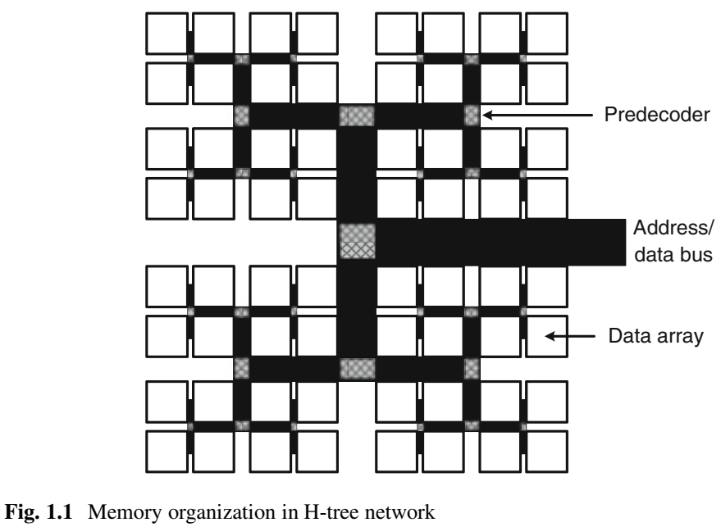
Memory Organization
Memory Technologies, Spring 2024, AUT, Tehran, Iran

Slide 8
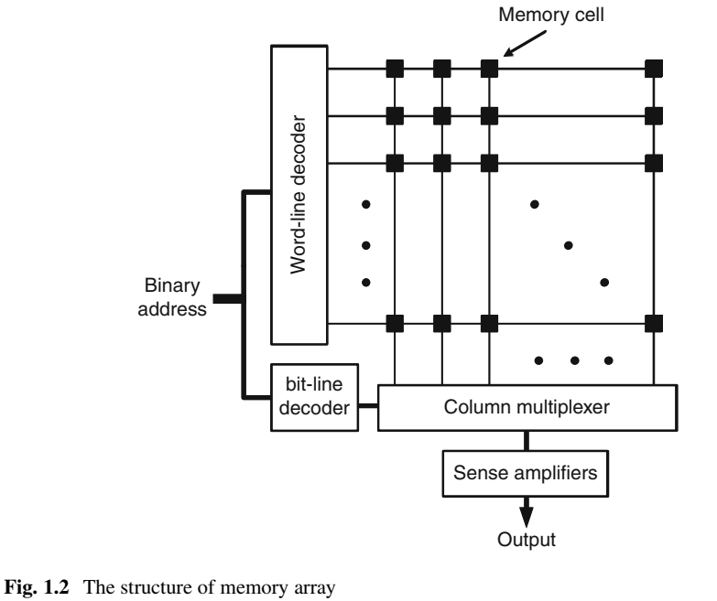
Data Array Structure
Memory Technologies, Spring 2024, AUT, Tehran, Iran

Slide 9
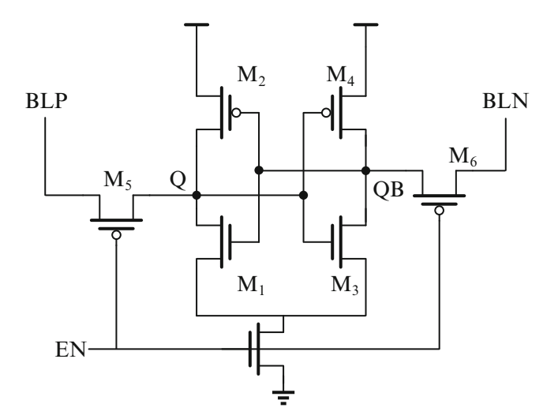
Latch-type Sense Amplifier
Memory Technologies, Spring 2024, AUT, Tehran, Iran

Slide 10
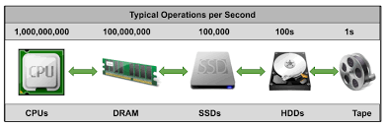
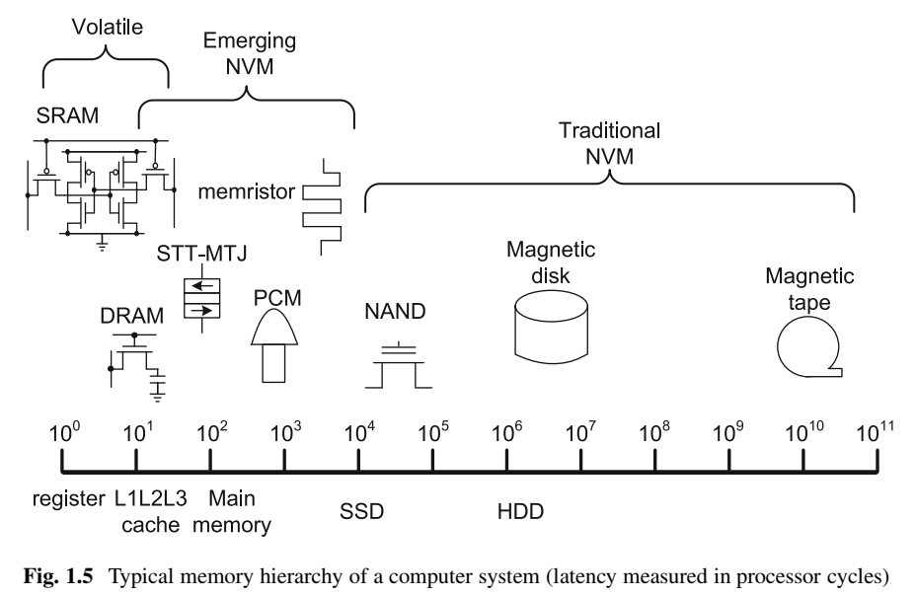
Memories Hierarchy
Memory Technologies, Spring 2024, AUT, Tehran, Iran

Slide 11
Traditional Semiconductor Memories
Silicon-transistor-based
Random access
Time it takes to access any data is identical regardless of the data location
Memory Technologies, Spring 2024, AUT, Tehran, Iran

Slide 12
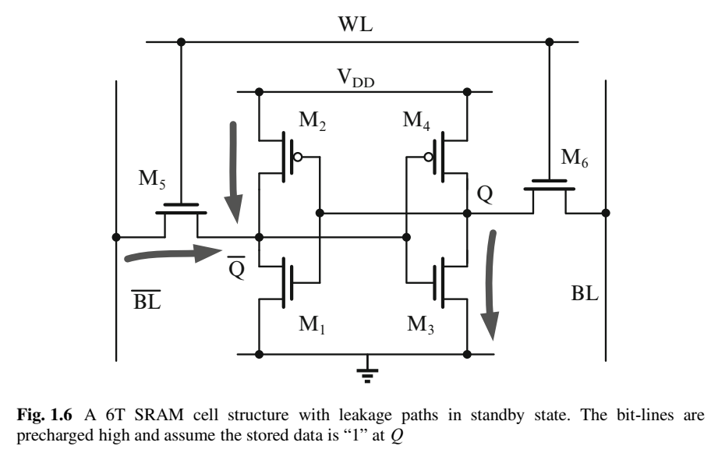
Static Random-Access Memory
Read
Write
Standby
Memory Technologies, Spring 2024, AUT, Tehran, Iran

Slide 13
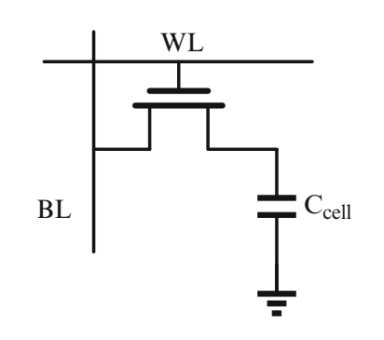
Dynamic Random-Access Memory
1T1C DRAM
Data presentation: capacitor charge
Retention time
Refresh
Read out and write back the cell content
Memory Technologies, Spring 2024, AUT, Tehran, Iran

Slide 14
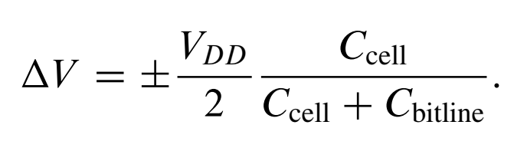
Dynamic Random-Access Memory
Write
Voltage drop on writing “1”
WL: Vpp = Vdd+Vth
Read
Bit-line Precharge
Memory Technologies, Spring 2024, AUT, Tehran, Iran

Slide 15
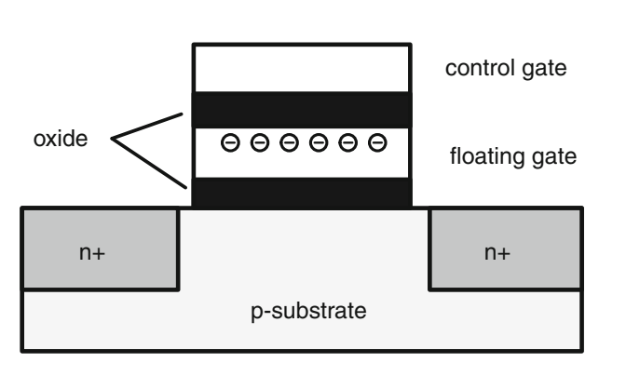
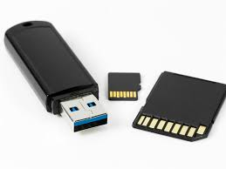
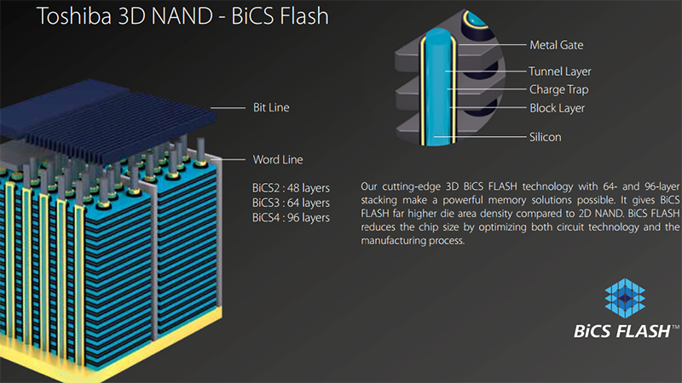
Flash Nonvolatile Memory
Floating gate transistors
Trap charges and keep them for years
Memory Technologies, Spring 2024, AUT, Tehran, Iran

Slide 16
Flash Nonvolatile Memory
Read operation
No charge trapped: Vth0
Negative charge trapped: Vth1
Apply intermidiate control gate voltage
Vth0 < Vg < Vth1
Measure the current
Write operation
Inject or pull electrons
Damaging oxide lattice: limited write cycle (10⁵)
Memory Technologies, Spring 2024, AUT, Tehran, Iran

Slide 17
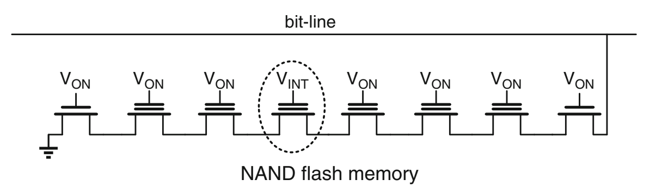

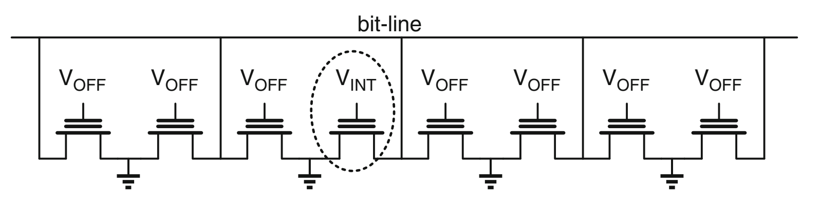
Flash Nonvolatile Memory
NAND flash
NOR flash
https://searchstorage.techtarget.com/definition/flash-memory#:~:text=Flash%20memory%2C%20also%20known%20as,data%20at%20the%20byte%20level.&text=Flash%20memory%20retains%20data%20for,is%20powered%20on%20or%20off.
Memory Technologies, Spring 2024, AUT, Tehran, Iran

